Slide 1



Hospital Stay Duration Analysis
Tracy Dower & Blake Armstrong
MSDS 6732 – Applied Statistics

Slide 2

Duration Matters
Analyze hospital stay duration
Why we care about hospital stay duration
What drives hospital stay duration?
Can we predict hospital stay duration?
Notes:
Every extra day a patient stays in the hospital comes with a cost. It increases the financial burden, and more importantly, it raises the risk of hospital-acquired infections and complications. That’s why it is critical to understand the factors driving hospital stay duration.
In this project, we worked with data from 113 hospitals across four U.S. regions.
First, what drives hospital stay duration? Our first objective was to determine which hospital characteristics most significantly influence the average length of stay for patients.
This is critical because when hospitals know what factors are driving longer stays, they can focus on what to control. This can lead to better patient outcomes, lower costs, and more efficient resource management.
This question is important because understanding these factors can help hospitals make data-driven decisions to improve patient care and resource management.
Understanding what drives length of stay can help hospitals control these factors, improve patient outcomes, and optimize resources.
Second, can we predict hospital stay duration?
Prediction matters because if hospitals can anticipate length of stay, they can plan ahead. They can better manage staffing, bed availability, and patient flow. This allows them to be proactive instead of reactive.
Data Objective(s) overview, project outline, and data description/variables used
Objective 1: Identify predictors that influence patient length of stay.
Objective 2: Build the most accurate predictive model for length of stay.
Dataset: 113 hospitals, 11 key variables including infection risk, number of beds, and region.

Slide 3

EDA Highlights
Dataset includes: infection risk, patient age, number of beds, average patient load, medical school affiliation
No missing or invalid data
Regional differences in length of stay
Positive association: infection risk and length of stay
Multicollinearity between number of beds and average patient load
Notes:
The dataset contains key variables, including infection risk, patient age, number of beds, average patient load, and medical school affiliation status.
Data Quality: No missing or invalid data were identified.
Key Patterns: Distinct regional differences in average length of stay were observed.
Relationship: Infection risk shows a positive association with length of stay.
Issue: Multicollinearity was detected between the number of beds and the average patient load.

Slide 4
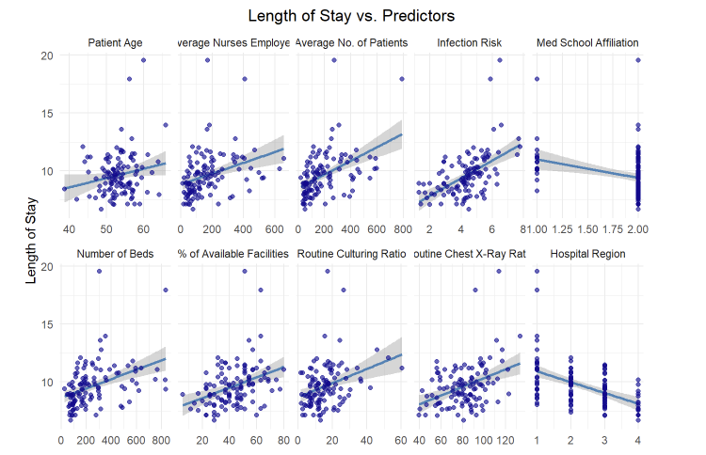
Length of Stay vs. Predictors
Notes:
This visual shows the relationship between hospital length of stay and each predictor in our dataset.
Several patterns stand out:
Patient Age: There’s a positive trend—older patient populations are generally associated with longer hospital stays.
Average Number of Nurses and Patients: Hospitals with more nurses and more patients tend to have longer stays. This may reflect larger or busier hospitals, but these variables are also highly correlated with hospital size.
Infection Risk: Higher infection risk is associated with longer stays, which makes sense—complications from infections often extend recovery time.
Medical School Affiliation: Hospitals with a medical school affiliation tend to have slightly shorter stays, possibly due to more standardized or cutting-edge practices, but this relationship is not very strong visually.
Number of Beds: Length of stay increases with hospital size, but this is likely confounded by the same size effects we see with number of patients and number of nurses.
Available Facilities: Surprisingly, there’s no strong trend here. The percent of available facilities does not seem to strongly impact length of stay.
Routine Culturing and Chest X-Ray Ratios: There is a mild positive association, especially for chest X-rays, which could reflect hospitals that are more proactive in diagnostics having longer stays.
Hospital Region: There are clear regional differences in length of stay. Some regions tend to have systematically longer or shorter stays.
Overall, infection risk, patient age, hospital size, and regional differences appear to be key drivers of length of stay, which guided our model selection process.

Slide 5
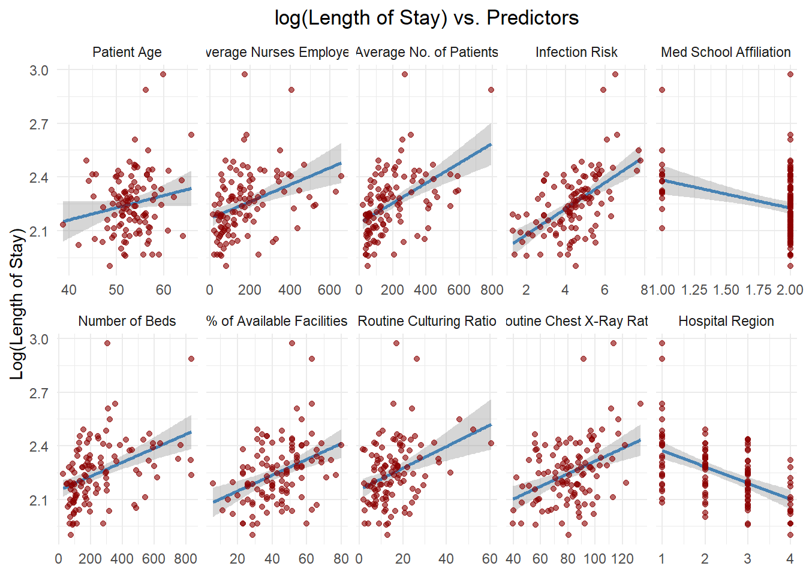
Predictors and the log of hospital stay duration
Notes:
Log-Transformed Plot:
Here we see the relationship between the predictors and the log of hospital stay duration.
Log-transforming hospital stay duration can help stabilize variance and improve linearity, making the relationships easier to model.
Key Takeaways:
Patient Age: The positive association remains. Older patient populations are generally linked to longer stays, even after log transformation.
Average Number of Nurses and Patients: Both show clearer linear relationships in the log scale. Larger hospitals with more nurses and more patients tend to have longer stays, but now the trend is more consistent.
Infection Risk: Still positively associated with longer stays, and the spread is more even after the log transformation.
Medical School Affiliation: Hospitals affiliated with medical schools still show slightly shorter stays, though this pattern is subtle.
Number of Beds: The association with longer stays is more stable and less influenced by outliers in the log scale.
% of Available Facilities: The trend is slightly more visible here compared to the untransformed plot, though it remains a weaker predictor.
Routine Culturing and Chest X-Ray Ratios: Both continue to show mild positive relationships. These may reflect more diagnostic activity in hospitals with longer stays.
Hospital Region: The regional differences persist. Some regions consistently have longer or shorter stays.
Summary: Log transformation improved the linear relationships and reduced the impact of outliers, supporting our decision to explore both transformed and untransformed models. It helps clarify which predictors have stable, linear associations with length of stay.

Slide 6
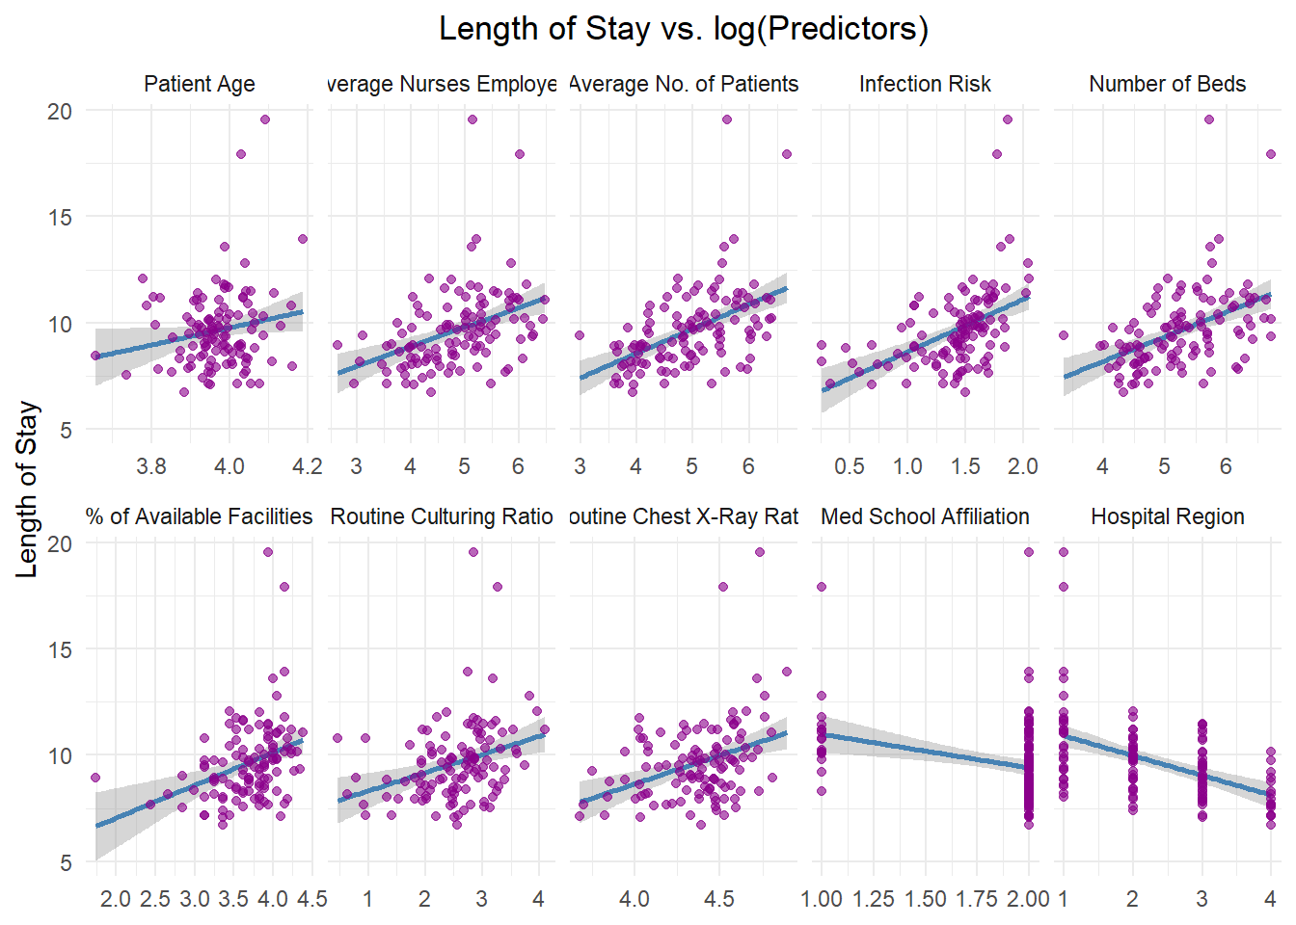
Length of Stay vs. log(Predictors):
Notes:
Discussing Length of Stay vs. log(Predictors):
In this plot, we used log-transformed predictors to explore whether log-scaling the independent variables would reveal clearer or more stable relationships with hospital stay duration.
Key Observations:
Log(Patient Age), Log(Number of Nurses), Log(Number of Patients), and Log(Number of Beds): These predictors still show a positive relationship with length of stay. Log-transforming the predictors makes the trends more linear and reduces the influence of extreme values on the x-axis.
Log(Infection Risk): The positive association remains clear. Log-transforming infection risk tightens the spread and provides a more stable relationship.
Log(% of Available Facilities), Log(Routine Culturing Ratio), and Log(Routine Chest X-Ray Ratio): These variables now show a stronger, more linear relationship with length of stay compared to when they were untransformed.
Medical School Affiliation: Hospitals affiliated with medical schools still tend to have slightly shorter stays, but the effect remains subtle.
Hospital Region: Regional differences are still visually apparent, with some regions associated with longer average stays.
Summary Line: Using log-transformed predictors helped improve linearity, reduce skewness, and stabilize variance across several key predictors, supporting the idea that log transformations can be a useful modeling strategy in this dataset.
Ask ChatGPT

Slide 7
Objective 1: Model 1: Linear Regression with Untransformed Predictors
Model: Length of Stay ~ Age + Inf.Risk + R.Cul.Rat + R.CX.ray.Rat + Avg.Pat + Avg.Nur + Pct.Ser.Fac + Region
MSE: 1.1049
Significant Predictors: Age, Inf.Risk, Avg.Pat, Avg.Nur, Region
Example: 1% increase in infection risk increases length of stay by ~0.53 days (95% CI: 0.24 to 0.81 days).
Notes:
Model 1: Linear Regression with Untransformed Predictors
We started by fitting a baseline linear regression model using infection risk as the sole predictor for length of stay.
Cross-Validation Results (5-fold, 10 repeats):
RMSE: 1.878
R-squared: 0.051
MAE: 1.369
Interpretation:
This model explains very little variance in the outcome.
The low R-squared value confirms that infection risk alone is not sufficient to predict hospital stay duration accurately.
Additional Observations:
Similar to what we saw in the linear scatterplots, most of the data clusters at the lower end of the predictor range.
This supports the idea that variable transformations, such as log-scaling, could improve the model fit and help reduce the skewed distribution.
Model: Length of Stay ~ Age + Inf.Risk + R.Cul.Rat + R.CX.ray.Rat + Avg.Pat + Avg.Nur + Pct.Ser.Fac + Region
MSE: 1.1049
Significant Predictors: Age, Inf.Risk, Avg.Pat, Avg.Nur, Region
Example: 1% increase in infection risk increases length of stay by ~0.53 days (95% CI: 0.24 to 0.81 days).
TURNER’s iunstructions: MLR model (Objective 1)
Describe the general approach to building your modeling to answer the primary question. This can be based on the question, linking key insight from EDA and/or incorporating information from feature selection or AIC model comparisons, etc
Produce an equation for the model (If its too long just make sure it is clearly stated what predictors are being used)
Groups should consider carefully what tests and/or confidence intervals could be used to help answer the objectives question(s). In addition to addressing the objective, there should be at least one formal interpretation of a regression coefficient along with a confidence interval. For some objectives, additional interpretations or summaries may be needed. It is up to the group to decide on what is appropriate. The groups may use any MLR related tests from last semester as well as partial F-tests.

Slide 8
Average Length of Stay vs. Infection Risk Key Findings from the Full Model
Key Findings from the Full Model:
When holding all other variables constant:
Infection Risk is statistically significant. Each 1% increase in infection risk is associated with a 0.43-day increase in length of stay (95% CI: 0.18 to 0.68 days, p < 0.001).
Other significant predictors:
Age
Region
Average Patients
Average Nurses
Multicollinearity: Number of Beds and Average Patients
Notes:
As introduced earlier, Objective 1 is to determine whether a hospital’s infection risk is significantly associated with average length of stay, after accounting for other potentially influential factors.
We used multiple strategies:
Traditional multiple linear regression with all predictors
Stepwise feature selection (forward, backward, both)
LASSO regression
These methods allowed us to verify the importance of infection risk while controlling for other hospital characteristics.
Key Findings from the Full Model:
When holding all other variables constant:
Infection Risk is statistically significant. Each 1% increase in infection risk is associated with a 0.43-day increase in length of stay (95% CI: 0.18 to 0.68 days, p < 0.001).
Other significant predictors:
Age: Older patient populations are linked to longer stays.
Region: Regional differences significantly affect length of stay.
Average Patients: Larger hospitals with more daily patients tend to have longer stays.
Average Nurses: Higher nurse staffing is slightly associated with shorter stays.
Multicollinearity: VIF scores flagged Number of Beds and Average Patients as highly correlated (VIF > 30), indicating possible redundancy.

Slide 9
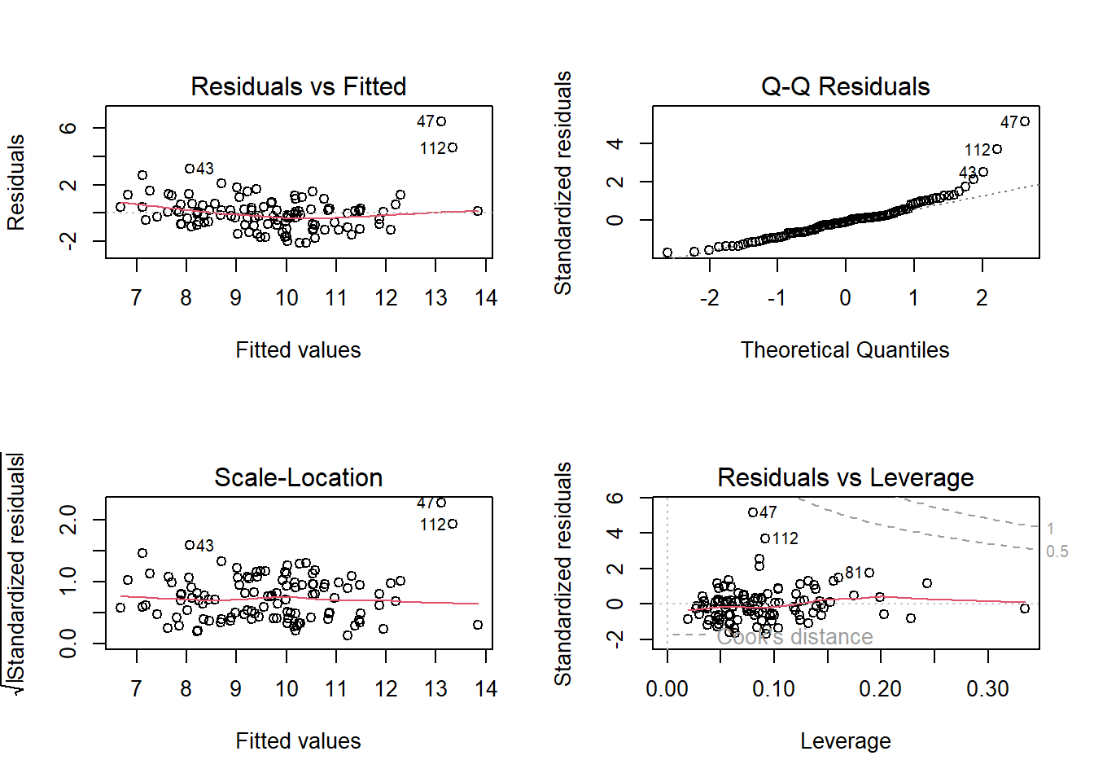
Residual Diagnostics: Model 1
Notes:
Residual Diagnostics: Model 1
We evaluated the assumptions of the linear regression model using residual plots.
Key Findings:
Residuals vs. Fitted: The residuals are generally centered around zero, but there’s noticeable variability at lower fitted values. There is also a slight curvature, suggesting potential non-linearity.
Q-Q Plot: The residuals deviate from the theoretical normal line, especially in the upper tail. This indicates that the residuals are not perfectly normally distributed, and there may be some outliers or heavy-tailed behavior.

Slide 10
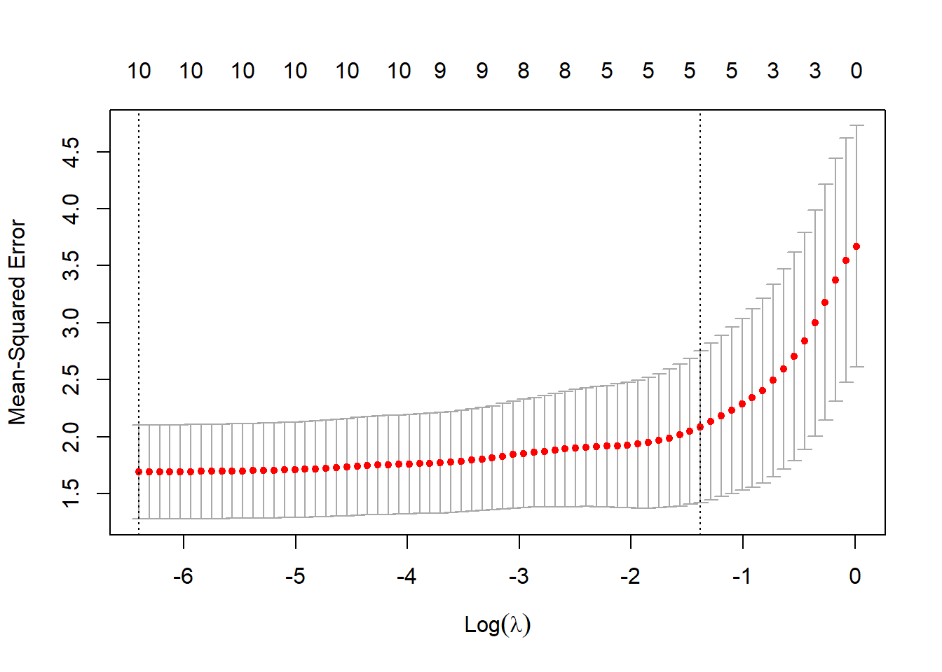
Automatic Feature Selection: LASSO
Notes:
Automatic Feature Selection: LASSO For our linear-linear model, we applied LASSO regression to automatically select predictors and control model complexity.
We used cross-validation to find the optimal penalty term, lambda (λ), that minimizes the mean squared error.
This plot shows the LASSO cross-validation results.
The x-axis represents different values of log(λ).
The y-axis shows the mean squared error (MSE) for each lambda.
The vertical dashed line indicates the λ value that minimizes the MSE.
Key Takeaways:
The lowest mean squared error occurred at the selected lambda, which balances prediction accuracy and model simplicity.
LASSO effectively reduced the number of predictors by shrinking some coefficients to zero, helping to control overfitting and multicollinearity.
The final model retained only the most relevant variables for predicting hospital stay duration.

Slide 11
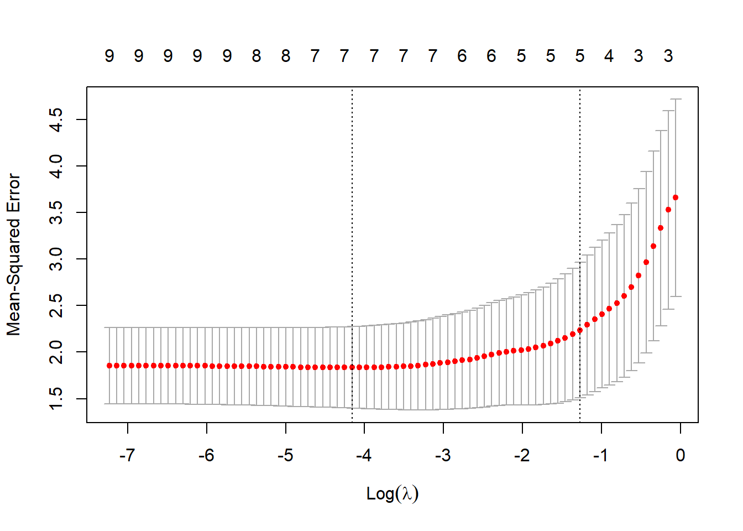
Automatic Feature Selection of Linear-Log:
Notes:
Skip this??

Slide 12
Objective 1: Final Model – Simple Linear Regression
Characteristic | Beta | 95% CI | p-value | VIF
(Intercept) | 3.241 | 0.104 to 6.379 | 0.043
Age | 0.079 | 0.027 to 0.131 | 0.003 | 1.0
Inf. Risk | 0.453 | 0.241 to 0.664 | <0.001 | 1.5
R. CX-ray Rat | 0.013 | 0.000 to 0.027 | 0.057 | 1.4
Avg. Patients | 0.010 | 0.006 to 0.013 | <0.001 | 5.8
Avg. Nurses | -0.007 | -0.011 to -0.003 | <0.001 | 5.9
Region | -0.618 | -0.860 to -0.376 | <0.001 | 1.1
Notes:
Objective 1: Final Model – Simple Linear Regression
After feature selection and diagnostics, we finalized a simplified multiple linear regression model that retained the most meaningful predictors.
Key Findings:
Infection Risk remains a highly significant predictor of hospital stay duration after adjusting for other factors.
Age, region, and hospital size (patients and nurses) also significantly influence length of stay.
Higher nurse staffing is associated with shorter stays, suggesting that better resourcing may improve patient throughput.
Low VIF values indicate minimal multicollinearity in this simplified model.
Next Step:
We will now review the residual diagnostics for this final model to confirm the model assumptions and overall fit.

Slide 13

Advanced Modeling of Hospital Length of Stay
Notes:
In Objective 2, we examined whether a hospital’s infection risk is significantly associated with the average length of patient stay, after accounting for other factors.
Unlike Objective 1, we introduced model complexity by exploring interaction terms and nonparametric methods.
TURNER SAID:
Objective 2 – Complex Modeling and Comparison
Nonadditive/Complex MLR model for Objective 2
Remind us what EDA graphics support your idea of including any potential interactions. If you think its weak support of including an interaction, just communicate that. Hopefully we will see some evidence of needing interactions, but if you cannot find any, show us a few graphs of what seems like it may be helpful to consider, even if it is a stretch visually.
Make sure the model is clearly stated. What predictors are included additively? What interactions and what polynomial terms have been added? If feature selection suggests that you do not include any interaction terms, state this and include them anyways as an experiment.
Model Comparisons for Objective 2
Compare objective 1 model, the complex MLR model from #4, and at least one addition nonparametric mode using an appropriate error metric. Interpret MSE if applicable
Conclusions: General Findings / Scope of inference / What would you do if given more time / Would you use this moving forward / etc
We approached this by creating both simple and complex multiple linear regression models, as well as a nonparametric model using LASSO regression.

Slide 14
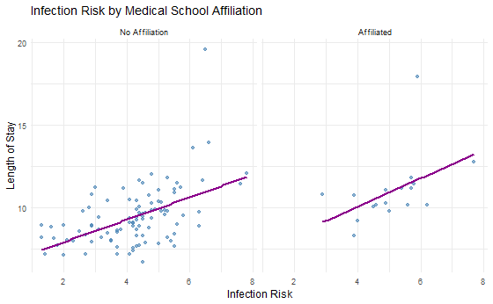
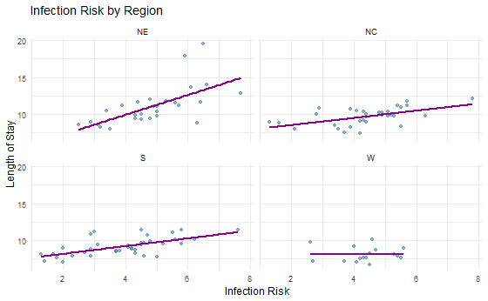
Interactions
Notes:
EDA Support for Interactions
Exploratory Data Analysis suggested some potential interactions.
The visual trends suggest potential interaction effects between infection risk and region, as the strength of the relationship appears to differ across regions.
The was a much smaller difference in trends between hospitals affiliated with medical school affiliation and those that were not affiliated.
Affiliated hospitals show a slightly steeper positive trend, though visual evidence remains moderate.
Given the ambiguity, we proceeded to formally test these interactions.

Slide 15
Complex MLR Model (All Predictors and Interactions)
Notes:
We built a complex multiple linear regression model including:
All main effects
All interaction terms with Region and Med School Affiliation
Model Summary:
Some interaction terms showed statistical significance (e.g., Infection Risk x Region).
The model’s MSE: 1.75 — indicating a loss of precision due to overfitting.

Slide 16
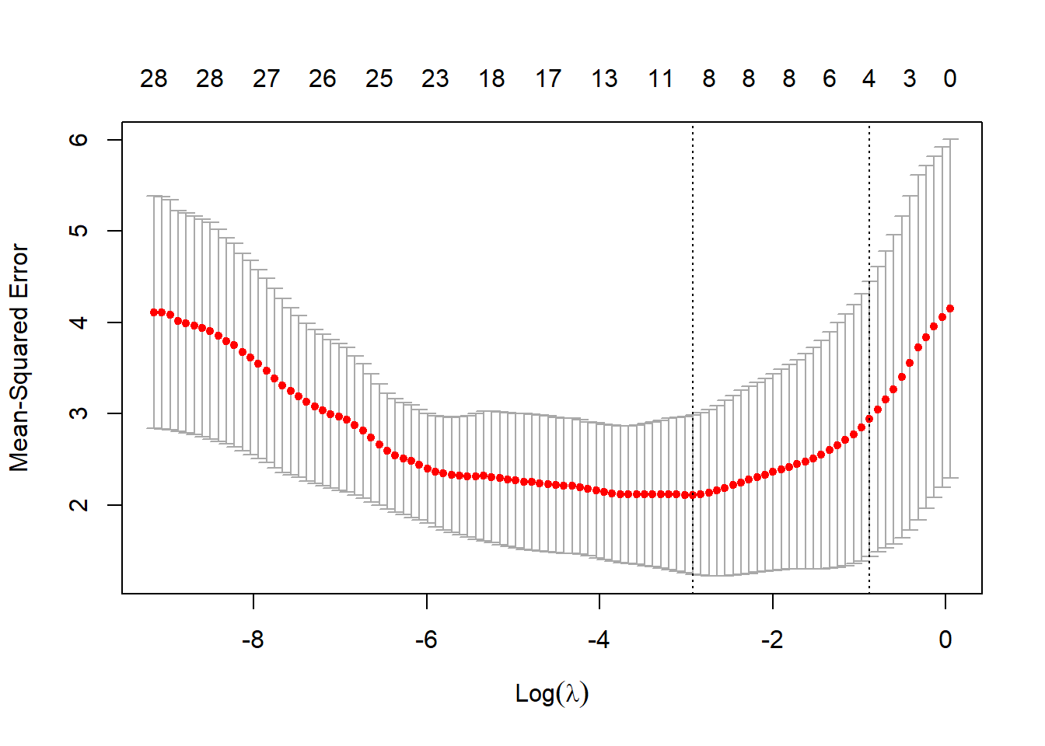
Feature Selection and Simplified Model
Notes:
Using stepwise selection, we reduced the model to key predictors and interactions:
Age, Infection Risk, Avg. Patients, Avg. Nurses
Significant interactions: Infection Risk x Region, Avg. Patients x Region, Avg. Nurses x Region
Results:
The simplified model improved precision.
MSE: 0.99, indicating better predictive accuracy.

Slide 17
Nonparametric Model: LASSO
Notes:
We also applied LASSO regression to automatically penalize and shrink less important variables.
Results:
LASSO selected fewer variables.
MSE: 1.21 — higher than the simplified MLR.
LASSO did not improve performance in this case.

Slide 18
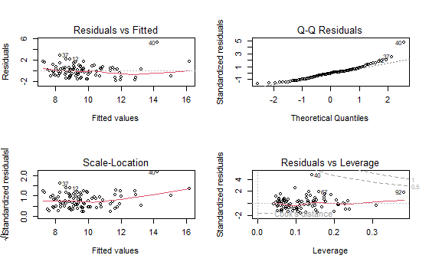
Residual Diagnostic Summary for Final Model
Notes:
Final Model Results and Residual Diagnostics
We tested a final refined model that included key variables and select interaction terms. However, this model produced a higher RMSE of 1.31, indicating it underperformed compared to the simplified stepwise model (RMSE = 0.99).
We conducted bootstrap validation to assess model stability. The results supported the reliability of the simplified model and indicated that the final model’s performance was not an improvement.
Residual Diagnostic Summary for Final Model
Residuals vs. Fitted Plot: There is mild funneling in the residuals, suggesting potential non-constant variance (heteroscedasticity). The residuals are not perfectly scattered and show some curvature, indicating the model may not fully capture the variance structure.
Q-Q Plot: The residuals generally follow the theoretical quantile line but deviate in the upper tail, suggesting a possible departure from normality. This could slightly impact inference but is not a severe issue.
Scale-Location Plot: The spread of residuals increases slightly with higher fitted values. This reinforces the mild heteroscedasticity observed earlier.
Residuals vs. Leverage Plot: No points exhibit both high leverage and large residuals, meaning there are no highly influential observations affecting the model's results.

Slide 19
Objective 2: Complex MLR Model
Model includes interaction terms between numeric predictors and region/affiliation.
Best Model: Length of Stay ~ Age + Inf.Risk + Avg.Pat + Avg.Nur + Inf.Risk x Region + Avg.Pat x Region + Avg.Nur x Region
MSE: 0.9877

Slide 20
Nonparametric Model: LASSO
Cross-validated LASSO regression used for feature selection.
MSE: 1.2077
Did not outperform complex MLR model.

Slide 21
Model Comparison
Model | MSE
Objective 1 Model | 0.89
Complex MLR | 1.75
Stepwise MLR | 0.99
LASSO | 1.21
Final Model | 1.31
Notes:
The simplified stepwise model provided the best balance between complexity and predictive accuracy, even though the Objective 1 model performed slightly better in MSE.

Slide 22
What are the weaknesses
Infection risk and region significantly influence length of stay.
Complex MLR model provides the best predictive performance.
Future work: Test additional nonparametric methods, collect more data, explore more interaction terms.
Scope of inference: Hospitals with similar characteristics in the provided dataset.
Notes:
Infection risk is a significant predictor, particularly when considering hospital region.
Complex models can lead to overfitting with minimal performance gain.
Feature selection is essential to balance model interpretability and accuracy.
If Given More Time:
Explore additional nonparametric models like Random Forest or kNN.
Investigate potential non-linearities and time effects.

Slide 23
Conclusions
Infection risk and region significantly influence length of stay.
Complex MLR model provides the best predictive performance.
Future work: Test additional nonparametric methods, collect more data, explore more interaction terms.
Scope of inference: Hospitals with similar characteristics in the provided dataset.
Notes:
Infection risk and region significantly influence length of stay.
Complex MLR model provides the best predictive performance.
Future work: Test additional nonparametric methods, collect more data, explore more interaction terms.
Scope of inference: Hospitals with similar characteristics in the provided dataset.

Slide 24
Conclusions
Infection risk and region significantly influence length of stay.
Complex MLR model provides the best predictive performance.
Future work: Test additional nonparametric methods, collect more data, explore more interaction terms.
Scope of inference: Hospitals with similar characteristics in the provided dataset.

Slide 25

Thank you
Tracy Dower & Blake Armstrong
MSDS 6732 – Applied Statistics

